Slide 1


CSE 470 – Unit Testing
BRAC University

Slide 2
Testing
Manual Testing
Automated Testing
Done by Development team – developers, testers
Done by Users
Refers to using the software and identifying problems
Generally uses excel sheet or similar tools to keep track of traces
Refers to writing and running test cases and to identify problems
Can be done in many ways – testing libraries, automated testing tools

Slide 3
Manual Testing Example

Slide 4
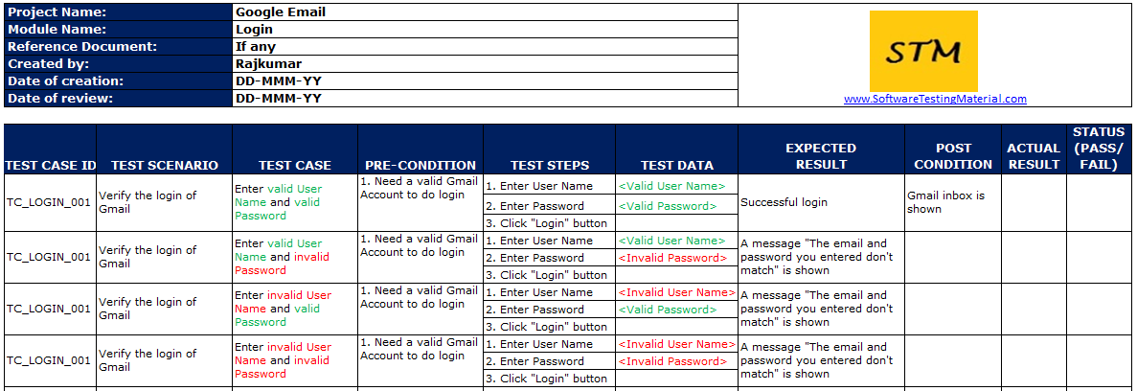
Manual Testing Example

Slide 5
Unit Testing
Unit testing is a type of automated testing to check if the small piece of code is doing what it is suppose to do.
Unit testing checks a single component of an application. The components are methods / functions
The scope of Unit testing is narrow, it covers the Unit or small piece of code under test. Therefore while writing a unit test shorter codes are used that target just a single class.
Unit testing comes under White box testing type.

Slide 6


Example – Math Test
Developers prepares some prearrangements known as ,TEST SETUP,
For each unit, create a TEST METHOD/CASE. Then, write the TEST STATEMENTS in the method which will call the unit under test.
The unit under test will execute and return a result known as, ACTUAL RESULT.
The test method have the right result known as, EXPECTED RESULT and compares it with the previous actual result,
The comparison identifies whether the unit passed or failed.
Teacher prepares the question set
Give each question to students who appear under the test.
Students do the math and return the calculated result
The teacher knows the right result and compares it with the student’s calculated result.
Mark the student pass / fail

Slide 7
How to write unit tests
A TEST CASE is a set of conditions or variables or instructions under which a tester will determine whether a system under test satisfies requirements or works correctly.
Setup / pre-conditions are usually defined as a separate property of the test case. Are generally written under the setup method.
test steps: instructions / statements written with in the test method
a predefined expected result is required for invoking the unit

Slide 8
Please watch the next video on writing unit tests for detailed understanding

